Slide 1
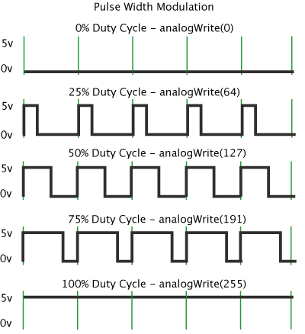
PWM (Pulse Width Modulation)
Yao-Tung Tsou
Notes:
http://www.modmypi.com/blog/hc-sr04-ultrasonic-range-sensor-on-the-raspberry-pi
http://www.raspberrypi-spy.co.uk/2012/12/ultrasonic-distance-measurement-using-python-part-1/
http://atceiling.blogspot.tw/2014/03/raspberry-pi_18.html#.Vi-G-WvXp9A

Slide 2
What is PWM?
PWM
Pulse-width modulation
Pulse-duration modulation
A modulation technique used to encode a message into a pulsing signal.

Slide 3
What is PWM?
It can be used to
encode information for transmission
allow the control of the power supplied to electrical devices, especially to inertial loads such as motors.
In addition, PWM is used in photovoltaic solar battery chargers,.

Slide 4
What is PWM?
The average value of voltage (and current) fed to the load (the device that uses the power) is controlled by turning the switch between supply and load on and off at a fast rate.
The longer the switch is on compared to the off periods, the higher the total power supplied to the load.

Slide 5
What is PWM?
The PWM switching frequency has to be much higher than what would affect the load
the resultant waveform perceived by the load must be as smooth as possible.
Typically switching has to be done several times a minute in an electric stove
120Hz (i.e., 1/120=0.0083s) in a lamp dimmer
from few kilohertz (kHz) to tens of kHz for a motor drive
the tens or hundreds of kHz in audio amplifiers.

Slide 6
What is Duty Cycle (dc)?
The term duty cycle (dc) describes the proportion of 'on' time to the regular interval or 'period' of time;
A low duty cycle corresponds to low power, because the power is off for most of the time.
Duty cycle is expressed in percent, 100% being fully on.

Slide 7
PWM and dc
The main advantage of PWM is that power loss in the switching devices is very low.
When a switch is off there is practically no current, and when it is on and power is being transferred to the load, there is almost no voltage drop across the switch.
Power loss, being the product of voltage and current, is thus in both cases close to zero.
PWM also works well with digital controls, which, because of their on/off nature, can easily set the needed duty cycle.
PWM has also been used in certain communication systems where its duty cycle has been used to convey information over a communications channel.

Slide 8
PWM and dc

Slide 9
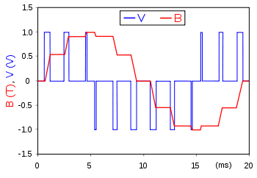
An example of PWM in an idealized inductor driven by a voltage source: the voltage source (blue) is modulated as a series of pulses that results in a sine-like current/flux (red) in the inductor.
The blue rectangular pulses nonetheless result in a smoother and smoother red sine wave as the switching frequency increases. Note that the red waveform is the (definite) integral of the blue waveform.

Slide 10
How to generate such wave?
Do you have any idea?

Slide 11
Wave Generation: 0/1 Cycle
While True:
GPIO.output(pin_number, 0)
time.sleep(value)
GPIO.output(pin_number, 1)
time.sleep(value)
What the LED will work?

Slide 12
Another Solution: PWM Function
To create a PWM instance:
GPIO.PWM(pin_number, frequency)
The unit of frequency is ‘Hz’
To start PWM:
p.start(dc) # where dc is the duty cycle (0.0 <= dc <= 100.0)
To change the frequency:
p.ChangeFrequency(freq) # where freq is the new frequency in Hz

Slide 13
Another Solution: PWM Function
To change the duty cycle:
p.ChangeDutyCycle(dc) # where 0.0 <= dc <= 100.0
To stop PWM:
p.stop()

Slide 14



Breath light: https://www.youtube.com/watch?time_continue=1&v=DiHDgw9Gq-8
Try to do a breath light!

Slide 15
The Other Solution: WiringPi
The WiringPi library appears to support both hardware PWM output on one GPIO pin and software PWM on any of the other GPIO pins.
This is a halfway house between hardware and software PWM, providing a 1 µs timing resolution compared to 100 µs with WiringPi's Software PWM

Slide 16
The Other Solution: WiringPi
Which of these is suitable for your applications depends on how many PWM outputs you need and what performance you want out of those outputs.
If your application is tolerant of low-timing resolution and high jitter then you could use a software assisted timing loop.
If you want higher precision / lower jitter PWM then you may need hardware assistance.

Slide 17
The Other Solution: WiringPi
Comments will be exploited
gpio mode 1 pwm #sets pin_num=1 to pwm mode
gpio pwm-bal #puts the pin into balanced PWM mode
gpio pwmr 1024 #sets the range to 1024
gpio pwm 1 500 #sets the output to 500

Slide 18
Software vs Hardware
If you want to flash a bunch of LEDs with different human visible cadences (10's of hertz) with soft real-time response requirements then the software loop could handle as many PWM's as you have GPIO pins.

Slide 19
Software vs Hardware
If you want to control a servo motor with hard real-time response requirements then you will need to use hardware PWM.

Slide 20
PWM to Control Motor
PWM is a technique for controlling power. We use it here to control the amount of power going to the motor and hence how fast it spins.

Slide 21
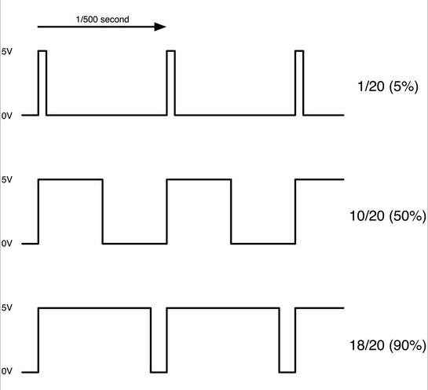
PWM to Control Motor
The diagram below shows the signal from the PWM pin of the Raspberry Pi.
How much dc is assigned in this diagram?

Slide 22
PWM to Control Motor
Every 1/500 of a second, the PWM output will produce a pulse.
The length of this pulse controls the amount of energy that the motor gets.
No pulse at all and the motor will not turn, a short pulse and it will turn slowly.
If the pulse is active for half the time, then the motor will receive half the power it would if the pulse stayed high until the next pulse came along.

Slide 23
Limitation and Solutions
Current is not enough when directly wiring gpio on the Pi to motor
Solutions:
(NPN) Transistor
L293D IC

Slide 24
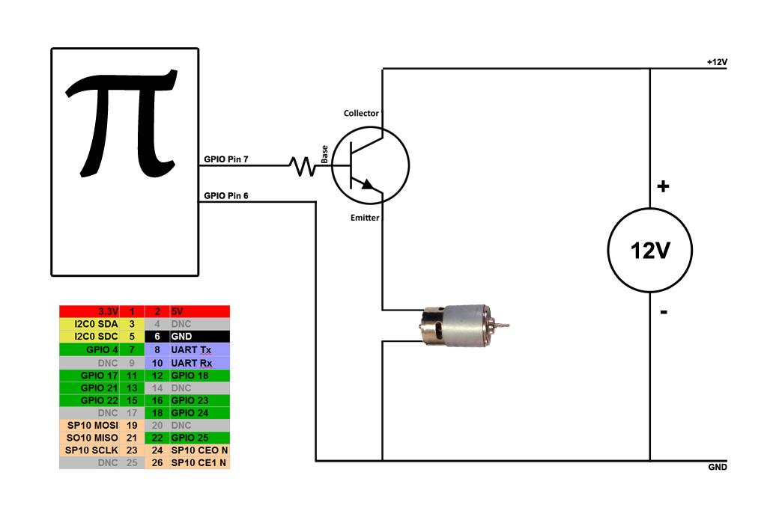
Transistor Connection
We don’t use this approach

Slide 25
L293D IC
It works on the concept of H-bridge. H-bridge is a circuit which allows the high voltage to be flown in either direction.
As you know voltage should change its direction to able to rotate the motor in clockwise or anticlockwise direction,
Hence H-bridge IC are ideal for driving a DC motor using micro-controller

Slide 26
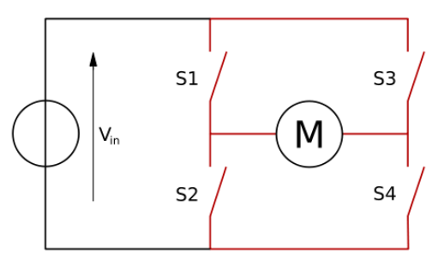
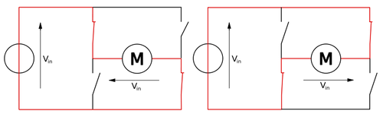
L293D IC
In a single l293d IC there two h-Bridge circuit inside the it which can rotate two dc motor independently.
Due to its size it is very much used in robotic application for controlling DC motors.

Slide 27
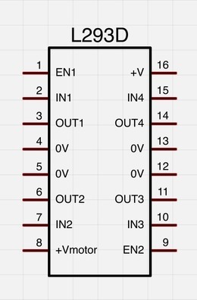
Working of L293D
There are two Enable pins on l293d.
Pin 1 and pin 9, for being able to drive the motor, the pin 1 and 9 need to be high.
For driving the motor with left H-bridge you need to enable pin 1 to high.
And for right H-Bridge you need to make the pin 9 to high.
If anyone of the either pin1 or pin9 goes low then the motor in the corresponding section will suspend working. It’s like a switch.

Slide 28
Working of L293D
The 4 input pins for this l293d, pin 2,7 on the left and pin 15, 10 on the right as shown on the pin diagram.
Left input pins will regulate the rotation of motor connected on the left side and right input for motor on the right hand side.
The motors are rotated on the basis of the inputs provided at the input pins as LOGIC 1 or LOGIC 0.
In simple you need to provide Logic 0 or 1 across the input pins for rotating the motor.

Slide 29
L293D Logic
Lets consider a Motor connected on left side output pins (pin 3,6). For rotating the motor in clockwise direction the input pins has to be given with Logic 1 and Logic 0.
Pin 2 = Logic 1 and Pin 7 = Logic 0 | Clockwise Direction
Pin 2 = Logic 0 and Pin 7 = Logic 1 | Anticlockwise Direction
Pin 2 = Logic 0 and Pin 7 = Logic 0 | Idle [No rotation] [Hi-Impedance state]
Pin 2 = Logic 1 and Pin 7 = Logic 1 | Idle [No rotation]
In a very similar way the motor can also operated across input pin 15,10 for motor on the right hand side.

Slide 30
Working of L293D
The L293D has two +V pins (8 and 16).
The pin '+Vmotor (8) ' provides the power for the motors, and
'+V (16) ' for the chip's logic.
You can connect pin 16 to the 5V pin of the Pi and pin 8 to a battery pack.
Pin 3 is wired to one of motor pin, and pin 6 is connected to the other one.
Pins 4 and 5 are connected to GND.

Slide 31
Please start to
run your motors

Slide 32
Functions
Some capabilities/functions you must have
Clockwise()
Counter_clockwise()
Change_speed()

Slide 33
Lab 5: Autonomous Mobile Control
R1: controlling two motors simultaneously.
R2: leveraging VNC (not limited) and give a commands to remotely control your autonomous mobile, such as forward, backward, turning right/left.

Slide 34
End

